Slide 1
Non-functional Requirements
Alejandro Montoya
Josue Santiago Cano
Angie Marcela Vargas

Slide 2

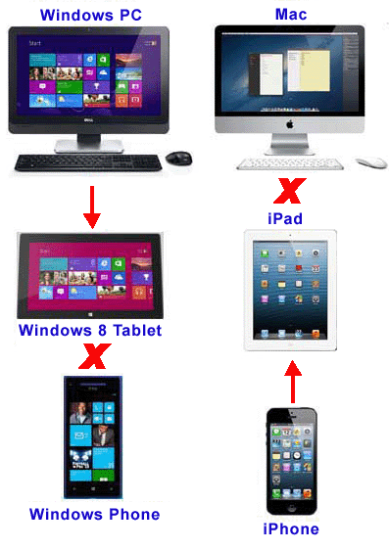
Platform Compatibility

Slide 3
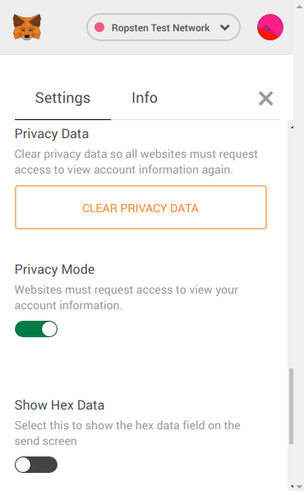

Privacy

Slide 4


Quality

Slide 5
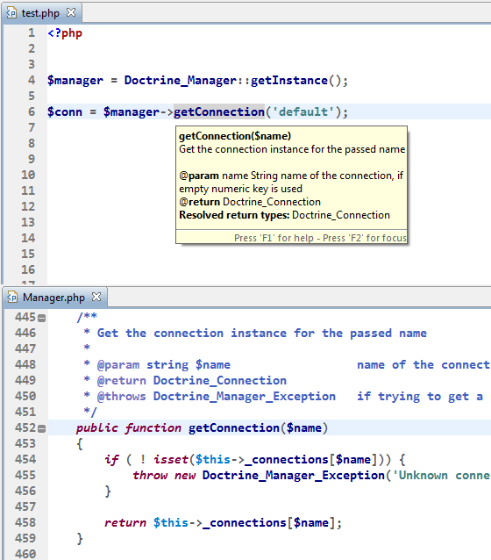

Readability

Slide 6
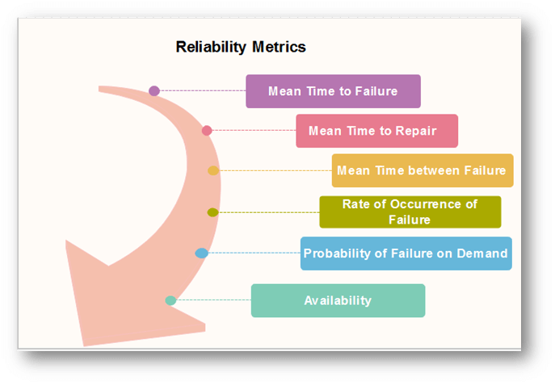
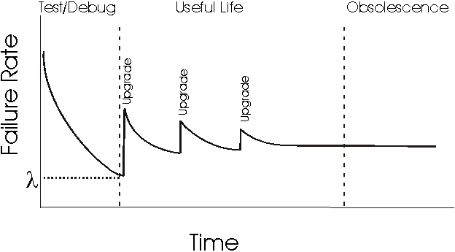
Reliability

Slide 7
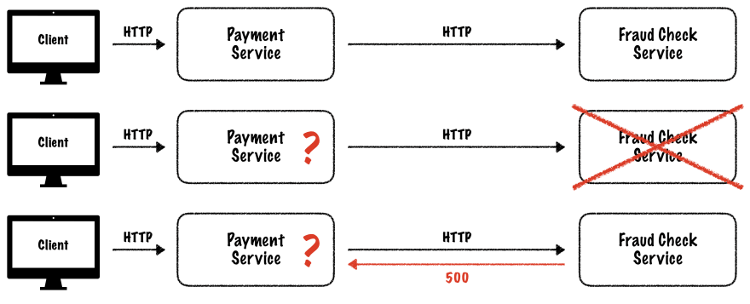
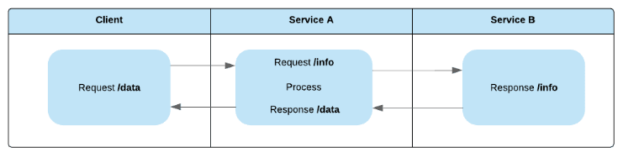
Resilience

Slide 8
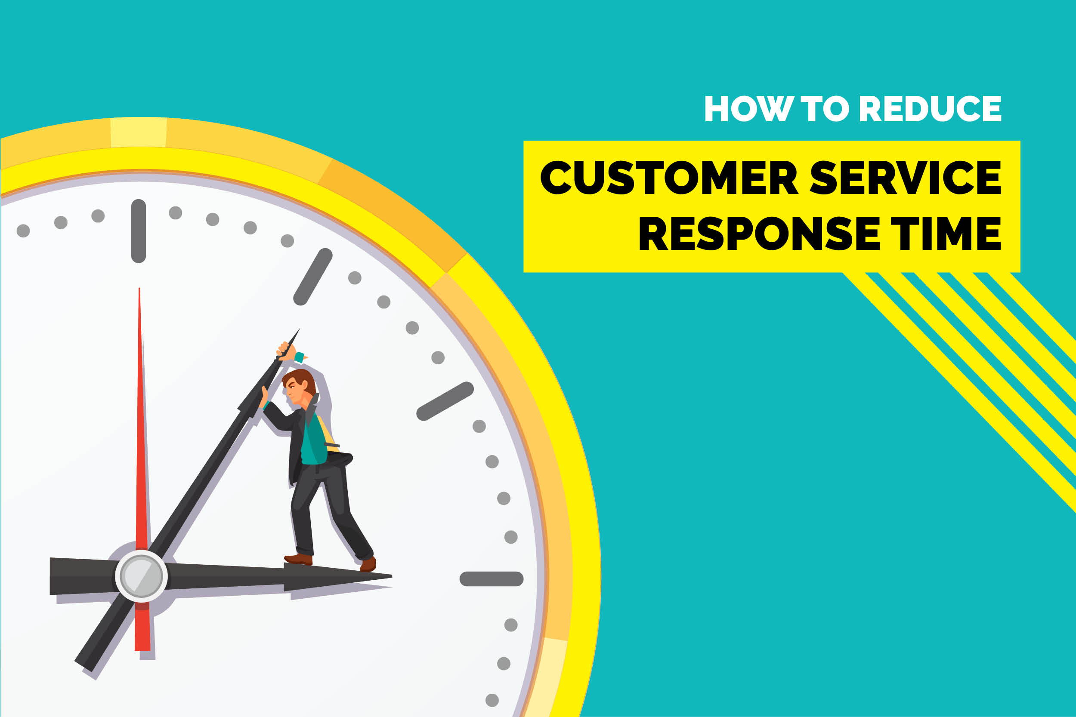
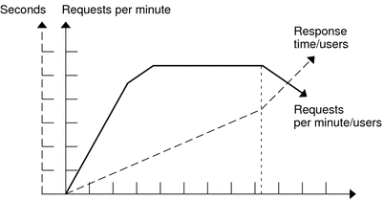
Response Time

Slide 9


Reusability

